Slide 1
Hostel Management System
Presented By:
1. Vempuluri Sindhu
2. Purini Jnana Prasanna
3. Nukaraju Vennela
Guided By:
Poovaragavan

Slide 2
OUTLINE
Abstract
Problem Statement
Proposed System/Solution
System Architecture
Conclusion
References
Future Scope

Slide 3
Abstract
“Hostel Management System” is a web based portal for students complaining about hostel issues for hostel. Where a student can raise a ticket about an issue in hostel and admin can assign a work for raised ticket to the employees. This portal is fully user controlled where a user can raise a complaint and user can see the status of the issue. The admin can be any registered user. He can control all the activities in the portal. He is responsible for assigning the complaints to employees that is raised by student. This portal is designed for the hostel students to complaint about the issues related to hostel. This portal is user friendly to students. We can conclude that our proposed model produced the highest accuracy while using .NET technology to build web based portal to complaint about issues in hostel.

Slide 4
Problem Statement
The Hostel Management System is developed for automating the complaints of Hostel. The software will be the great relief to the users The software will help user in case of complaints and see the status of the complaints and create as many as request is possible and can delete or edit the request .The aim of Hostel Management System is to carry out the complaints of hostel in an efficient way. It will take the operations of Hostel complaints to an upper level by providing faster access to data and allowing to create, delete ,edit and assign the work to the person . In existing system there is lot of manual work to overcome this we use .NET technology to build a website.

Slide 5
Proposed Solution
The project is aimed at developing a system for keeping records and showing information about hostel issues. The system will help the hostel office to be able to manage the problems of the hostel.It will shows the complaints raised by student to admin so that admin can assign work to the respected employees and they can see the work assigned to them.

Slide 6
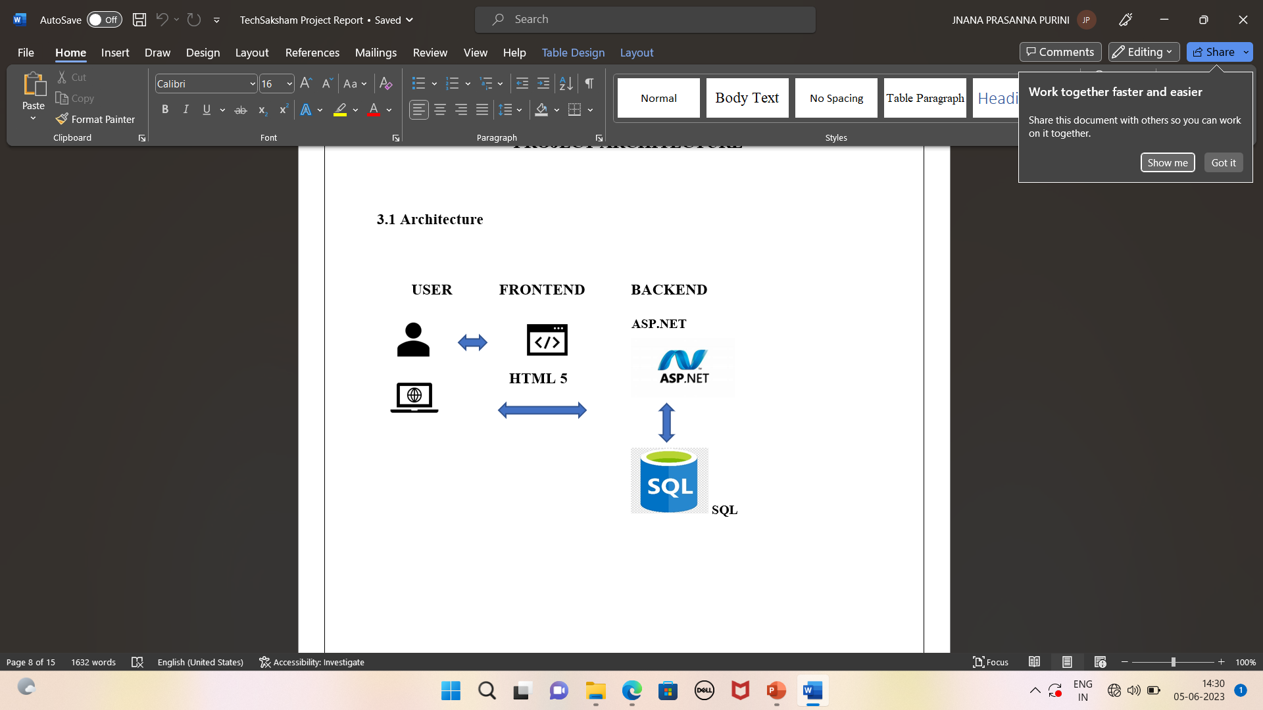
System Architecture

Slide 7
Conclusions
The Hostel Management System helps your organization improve workforce productivity and boost overall well-being by assigning work to the particular employee and user can easily raise a issue to solve. The Hostel Management System is developed in order to computerize the activities which take more time, if done manually. This study takes similar route, but with an improved and novel method and by using this portal the user can save their productive time. This website provides more accuracy to solve the problems within the time. The Hostel Management System is used to the student raise the problems by using the website and admin can assign or delete the work raised by student by using employee id and employee can see the work assigned by admin and edit the status of employee.

Slide 8
References and Future Scope
HTML Tutorials | HTML Dog
https://learn.microsoft.com/en-us/aspnet/core/mvc/overview?view=aspnetcore-7.0#modelbinding https://youtu.be/4IgC2Q5-yDE -kudvenkat channel https://www.w3schools.com/sql/
https://geekforgeeks.com
https://javatpoint.com
The future implementation of this project is adding CSS (cascading style sheet) and deploying in the cloud to manage it. Based on this everyone can use this website by deploying in cloud. After adding CSS (cascading style sheet) the page will look attractive to use.

Slide 9
THANK YOU

